Slide 1
Introduction to Internet

Slide 2
Agenda
Evolution of Internet
Internet Applications

Slide 3
Introduction to Internet
Internet is defined as an Information super Highway, to access information over the web. However, It can be defined in many ways as follows:
Internet is a world-wide global system of interconnected computer networks.
Internet uses the standard Internet Protocol (TCP/IP).
Every computer in internet is identified by a unique IP address.
IP Address is a unique set of numbers (such as 110.22.33.114) which identifies a computer location.
A special computer DNS (Domain Name Server) is used to give name to the IP Address so that user can locate a computer by a name.
For example, a DNS server will resolve a name http://www.amrita.edu to a particular IP address to uniquely identify the computer on which this website is hosted.
Internet is accessible to every user all over the world.

Slide 4
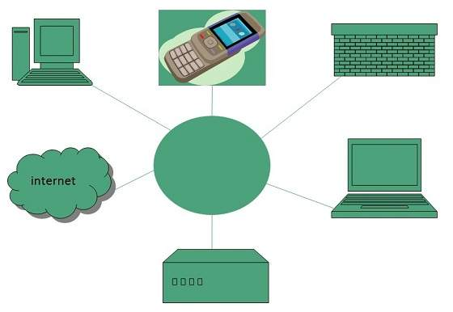
Introduction to Internet

Slide 5
Evolution of Internet
The concept of Internet was originated in 1969 and has undergone several technological & Infrastructural changes as discussed below:
The origin of Internet devised from the concept of Advanced Research Project Agency Network (ARPANET).
ARPANET was developed by United States Department of Defense.
Basic purpose of ARPANET was to provide communication among the various bodies of government.
Initially, there were only four nodes, formally called Hosts.
In 1972, the ARPANET spread over the globe with 23 nodes located at different countries and thus became known as Internet.
By the time, with invention of new technologies such as TCP/IP protocols, DNS, WWW, browsers, scripting languages etc.,Internet provided a medium to publish and access information over the web.

Slide 6
Internet Applications
Applications
Of the various services available via the Internet, the three most important are:
e-mail
web browsing
peer-to-peer services .
E-mail, also known as electronic mail, is the most widely used and successful of Internet applications.
Web browsing is the application that had the greatest influence in dramatic expansion of the Internet and its use during the 1990s.
Peer-to-peer networking is the newest of these three Internet applications, and also the most controversial, because its uses have created problems related to the access and use of copyrighted materials.

Slide 7
Internet Protocols

Slide 8
Agenda
TCP/IP
UDP
HTTP
Secure Http(Shttp)

Slide 9
TCP
Transmission Control Protocol (TCP)
TCP is a connection oriented protocol and offers end-to-end packet delivery. It acts as back bone for connection.It exhibits the following key features:
Transmission Control Protocol (TCP) corresponds to the Transport Layer of OSI Model.
TCP is a reliable and connection oriented protocol.
TCP offers:
Stream Data Transfer.
Reliability.
Efficient Flow Control
Full-duplex operation.
Multiplexing.
TCP offers connection oriented end-to-end packet delivery.
TCP ensures reliability by sequencing bytes with a forwarding acknowledgement number that indicates to the destination the next byte the source expect to receive.
It retransmits the bytes not acknowledged with in specified time period.

Slide 10
IP
Internet Protocol (IP)
Internet Protocol is connectionless and unreliable protocol. It ensures no guarantee of successfully transmission of data.
In order to make it reliable, it must be paired with reliable protocol such as TCP at the transport layer.
Internet protocol transmits the data in form of a datagram as shown in the following diagram:
The length of datagram is variable.
The Datagram is divided into two parts: header and data.
The length of header is 20 to 60 bytes.
The header contains information for routing and delivery of the packet.

Slide 11
UDP
User Datagram Protocol (UDP)
Like IP, UDP is connectionless and unreliable protocol. It doesn’t require making a connection with the host to exchange data. Since UDP is unreliable protocol, there is no mechanism for ensuring that data sent is received.
UDP transmits the data in form of a datagram. The UDP datagram consists of five parts as shown in the following diagram:
UDP is used by the application that typically transmit small amount of data at one time.
UDP provides protocol port used i.e. UDP message contains both source and destination port number, that makes it possible for UDP software at the destination to deliver the message to correct application program.

Slide 12
HTTP
Hyper Text Transfer Protocol (HTTP)
HTTP is a communication protocol. It defines mechanism for communication between browser and the web server. It is also called request and response protocol because the communication between browser and server takes place in request and response pairs.
HTTP Request
HTTP request comprises of lines which contains:
Request line
Header Fields
Message body
The first line i.e. the Request line specifies the request method i.e. Get or Post.
The second line specifies the header which indicates the domain name of the server from where index.htm is retrieved.
HTTP Response
Like HTTP request, HTTP response also has certain structure. HTTP response contains:
Status line
Headers
Message body

Slide 13
Secure Http(Shttp)
HTTP Secure (HTTPS) is an extension of the Hyper Text Transfer Protocol(HTTP) for secure communication over a computer network, and is widely used on the internet. In HTTPS, the communication protocol is encrypted by Transport Layer Security(TLS), or formerly, its predecessor, Secure Sockets Layer (SSL). The protocol is therefore also often referred to as HTTP over TLS, or HTTP over SSL.
The principal motivation for HTTPS is authentication of the accessed website and protection of the privacy and integrity of the exchanged data while in transit. It protects against man-in-the-middle attacks. The bidirectional encryption of communications between a client and server protects against eavesdropping and tampering of the communication. In practice, this provides a reasonable assurance that one is communicating without interference by attackers with the website that one intended to communicate with, as opposed to an impostor.

Slide 14
Internet Addressing

Slide 15
Agenda
Addressing Scheme – Ipv4 & IPv6
Network Byte Order
Domain Name Server and IP Addresses, Mapping .

Slide 16
Ipv4&IPV6
IPv4
32-bit (4 byte) address supporting 4,294,967,296 address (although many were lost to special purposes, like 10.0.0.0 and 127.0.0.0)
NAT can be used to extend address limitations
IP addresses assigned to hosts by DHCP or static configuration
IPSec support optional
Options integrated in header fields
IPv6
128-bit (16 byte) address supporting 228 (about 3.4 x 1038) addresses
No NAT support (by design)
IP addresses self-assigned to hosts with stateless address auto-configuration or DHCPv6
IPSec support required
Options supported with extensions headers (simpler header format)

Slide 17
Addressing Scheme – Ipv4&IPV6
IPv4
Mulitcast address space at 224.0.0.0/4
Has broadcast addresses for all devices
Uses 0.0.0.0 as unspecified address
Uses 127.0.0.1 as loopback address
Supports globally unique “public” addresses
Uses 10.0.0.0/8, 172.16.0.0/16, and 192.168.0.0/16 as “private” addresses
IPv6
Multicast address space at FF00::/8
No such concept in IPv6 (uses multicast groups)
Uses :: as unspecified address
Uses ::1 as loopback address
Supports globally unique unicast addresses
Uses FD00::/8 as unique local addresses

Slide 18
Network Byte Order
Network Byte Order refers to how bytes are arranged when sending data over a network. In TCP/IP, this is generally Big Endian. This means most significant byte in the smallest address in a word. Host Byte Order refers to how bytes are arranged when referring to the computer architecture of a host computing
Unfortunately, not all computers store the bytes that comprise a multibyte value in the same order. Consider a 16-bit internet that is made up of 2 bytes. There are two ways to store this value.
Little Endian − In this scheme, low-order byte is stored on the starting address (A) and high-order byte is stored on the next address (A + 1).
Big Endian − In this scheme, high-order byte is stored on the starting address (A) and low-order byte is stored on the next address (A + 1).
To allow machines with different byte order conventions communicate with each other, the Internet protocols specify a canonical byte order convention for data transmitted over the network. This is known as Network Byte Order.

Slide 19
Domain Name Server and IP Addresses Mapping .
DNS (Domain Name Server)
DNS is a host name to IP address translation service. DNS is a distributed database implemented in a hierarchy of name servers. It is an application layer protocol for message exchange between clients and servers.
Requirement
Every host is identified by the IP address but remembering numbers is very difficult for the people and also the IP addresses are not static therefore a mapping is required to change the domain name to IP address. So DNS is used to convert the domain name of the websites to their numerical IP address.
Domain : There are various kinds of DOMAIN :
Generic domain : .com(commercial) .edu(educational) .mil(military) .org(non profit organization) .net(similar to commercial) all these are generic domain.
Country domain .in (india) .us .uk
Inverse domain if we want to know what is the domain name of the website. Ip to domain name mapping.So DNS can provide both the mapping for example to find the ip addresses of geeksforgeeks.org then we have to type nslookup www.geeksforgeeks.org.

Slide 20
Name Servers
Namespace – Set of possible names, flat or hierarchical . Naming system maintains a collection of bindings of names to values – given a name, a resolution mechanism returns the corresponding value –
Name server – It is an implementation of the resolution mechanism.. DNS (Domain Name System) = Name service in Internet – Zone is an administrative unit, domain is a subtree.
Name to Address Resolution: The host request the DNS name server to resolve the domain name. And the name server returns the IP address corresponding to that domain name to the host so that the host can future connect to that IP address. Hierarchy of Name Servers Root name servers – It is contacted by name servers that can not resolve the name. It contacts authoritative name server if name mapping is not known. It then gets the mapping and return the IP address to the host.
Top level server – It is responsible for com, org, edu etc and all top level country domains like uk, fr, ca, in etc. They have info about authoritative domain servers and know names and IP addresses of each authoritative name server for the second level domains.
Authoritative name servers This is organization’s DNS server, providing authoritative hostName to IP mapping for organization servers. It can be maintained by organization or service provider. In order to reach cse.dtu.in we have to ask the root DNS server, then it will point out to the top level domain server and then to authoritative domain name server which actually contains the IP address. So the authoritative domain server will return the associative ip address.

Slide 21
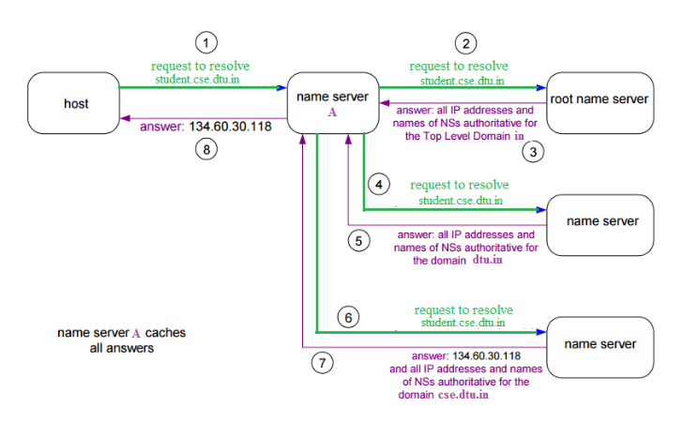

Slide 22
Internet Service Providers

Slide 23
Agenda
Different Types of Internet Connections:
Dial-Up (Analog 56K).
DSL
Cable
Wireless
Satellite
Cellular

Slide 24
Dial-Up
Dial-Up (Analog 56K).
Dial-up access is cheap but slow. A modem (internal or external) connects to the Internet after the computer dials a phone number. This analog signal is converted to digital via the modem and sent over a land-line serviced by a public telephone network. Telephone lines are variable in quality and the connection can be poor at times. The lines regularly experience interference and this affects the speed, anywhere from 28K to 56K. Since a computer or other device shares the same line as the telephone, they can’t be active at the same time.

Slide 25
DSL
DSL stands for Digital Subscriber Line. It is an internet connection that is always “on”. This uses 2 lines so your phone is not tied up when your computer is connected. There is also no need to dial a phone number to connect. DSL uses a router to transport data and the range of connection speed, depending on the service offered, is between 128K to 8 Mbps.

Slide 26
Cable
Cable provides an internet connection through a cable modem and operates over cable TV lines. There are different speeds depending on if you are uploading data transmissions or downloading. Since the coax cable provides a much greater bandwidth over dial-up or DSL telephone lines, you can get faster access. Cable speeds range from 512K to 20 Mbps.

Slide 27
Wireless
Wireless, or Wi-Fi, as the name suggests, does not use telephone lines or cables to connect to the internet. Instead, it uses radio frequency. Wireless is also an always on connection and it can be accessed from just about anywhere. Wireless networks are growing in coverage areas by the minute so when I mean access from just about anywhere, I really mean it. Speeds will vary, and the range is between 5 Mbps to 20 Mbps.

Slide 28
Satellite
Satellite accesses the internet via a satellite in Earth’s orbit. The enormous distance that a signal travels from earth to satellite and back again, provides a delayed connection compared to cable and DSL. Satellite connection speeds are around 512K to 2.0 Mbps.

Slide 29
Cellular
Cellular technology provides wireless Internet access through cell phones. The speeds vary depending on the provider, but the most common are 3G and 4G speeds. A 3G is a term that describes a 3rd generation cellular network obtaining mobile speeds of around 2.0 Mbps. 4G is the fourth generation of cellular wireless standards. The goal of 4G is to achieve peak mobile speeds of 100 Mbps but the reality is about 21 Mbps currently.

